Slide 1
Hotel Booking Demand
Cole Beach

Slide 2
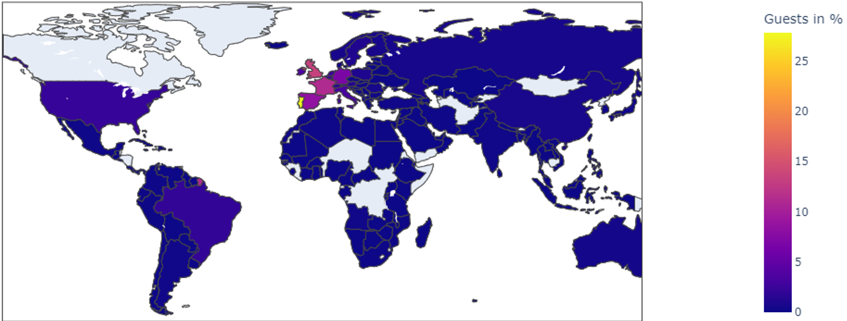
Where are guests traveling from?
We can see from the map above that the majority of those traveling in this dataset are from Portugal, followed by Great Britain, France, Spain, then Germany.

Slide 3
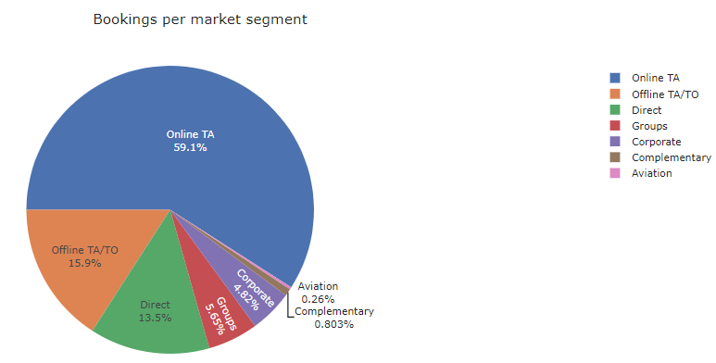
Who is Creating the Reservations?
We can see from the chart that Travel Agents are controlling the majority of the reservations made.

Slide 4
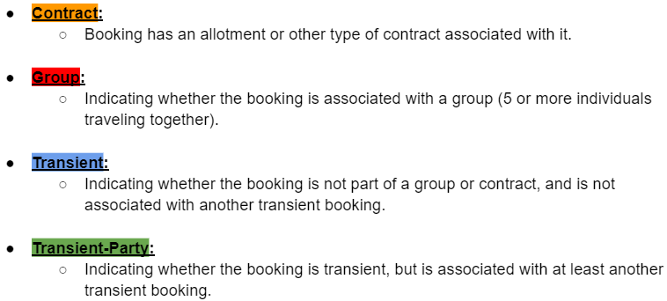
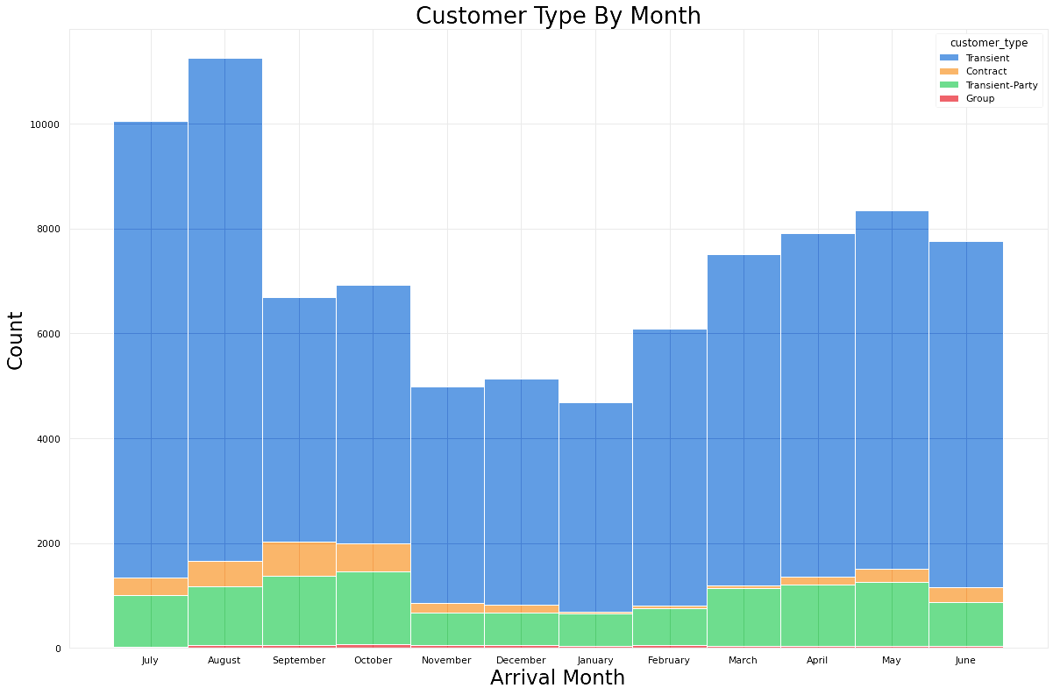
Customer Type

Slide 5
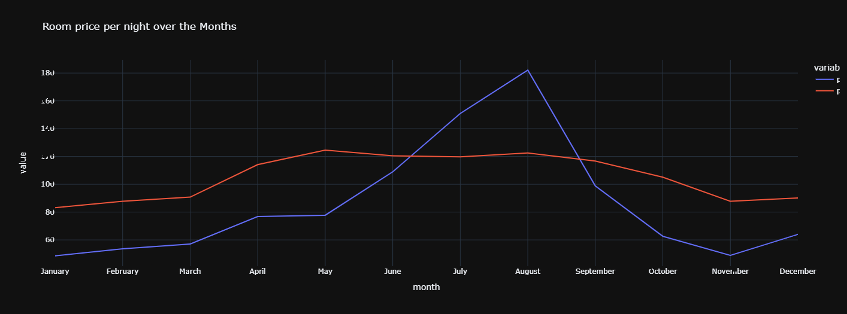
Peak Month for Resorts v.s. City Hotels
August is the peak for Resorts charging the most. By my own assumptions this can be a result to the end of summer break and families wanting to get those last minute travel plans. You can also see that there's an incline mid to late November going into December. This is for those looking to travel during the holidays and if they are traveling throughout Europe they'll get a chance to explore some beautiful Christmas Markets.

Slide 6
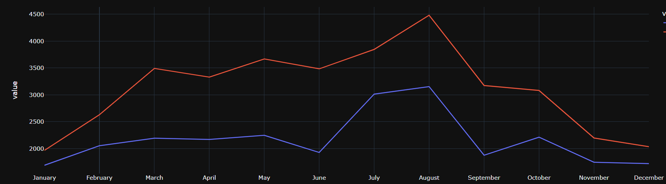
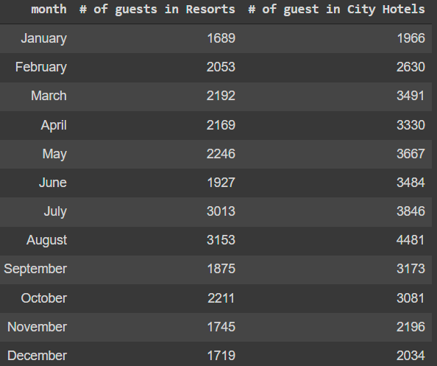
Busiest Month By Hotel Type
August not only is the peak for charging the most, it's also the peak for travel, which a major decline in September but slight spike in October which does have me curious. The spikes in March to May are for those looking to travel during Spring time and there could be a possible increase in certain destinations, such as Keukenhof, Amsterdam, for the Tulip Festival.

Slide 7
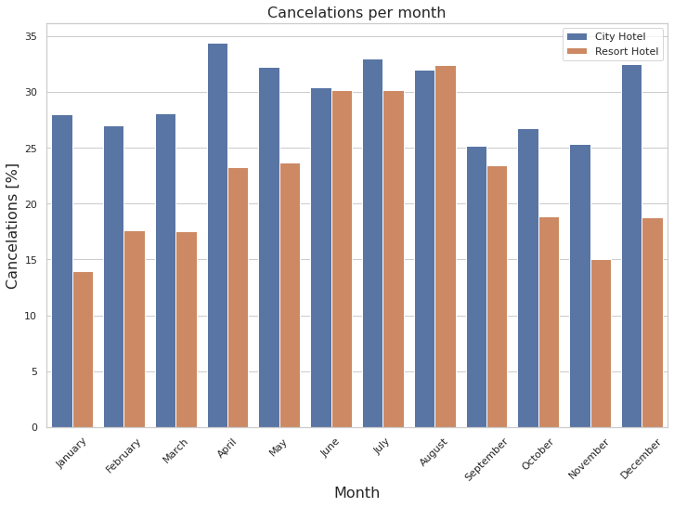

Cancellations Per Month
April is the highest month for City Hotel Cancellations whereas August has a slightly higher cancellation rate with the Resorts.
Overall the City Hotels have a 7% higher cancellation rate than Resorts. This can be attributed to a few different factors when you think about what a Resort is compared to a standard city hotel.

Slide 8
Which Model Should Be Used?
Recommendations
Our best model is retaining an 83% accuracy rating.
Travel agents, city hotels, and resorts will want to take a closer look into why there is an influx of cancellations during the months that are also their peak months for business, this could help with future advertisements and how businesses will approach future promotions. Travel agents will want to take a closer look at the reservations they are creating and why guests are cancelling when they are, this way they can retain their commission.

Slide 9
How to Contact Me:
LinkedIn
GitHub
Email

